Slide 1
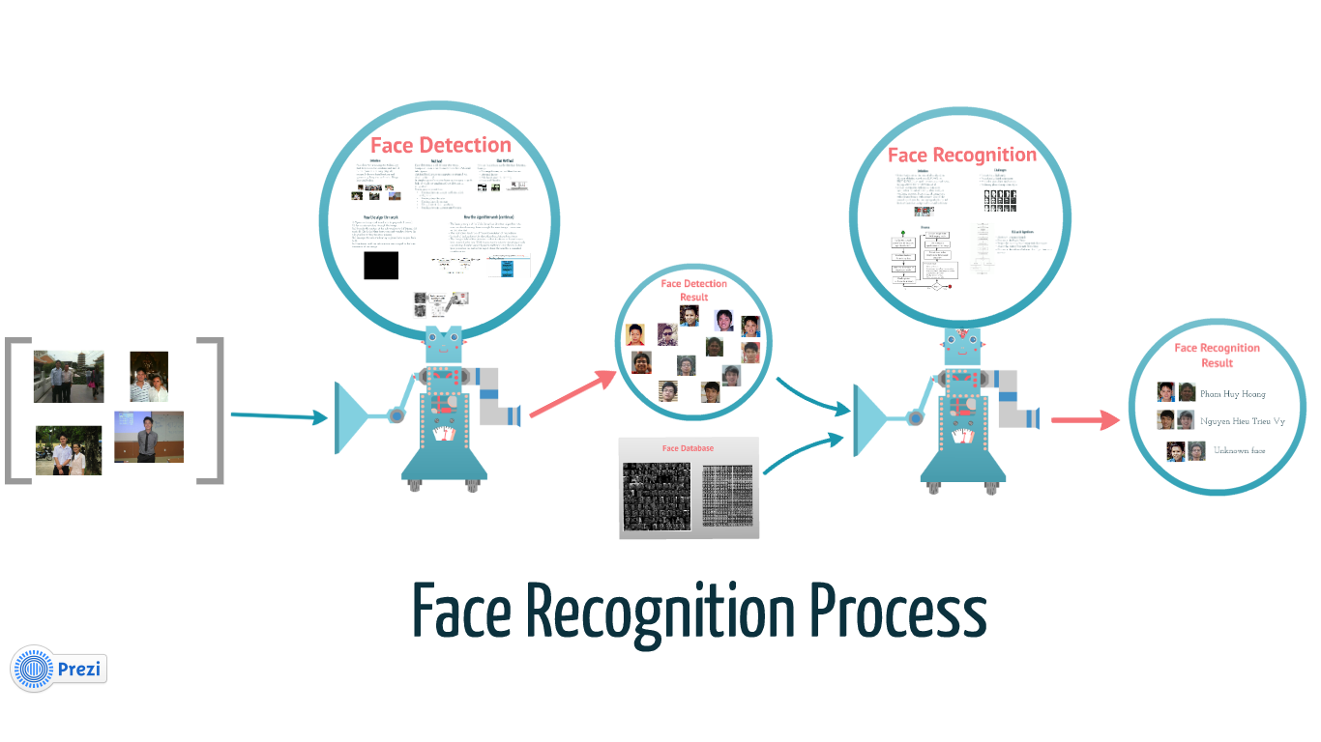
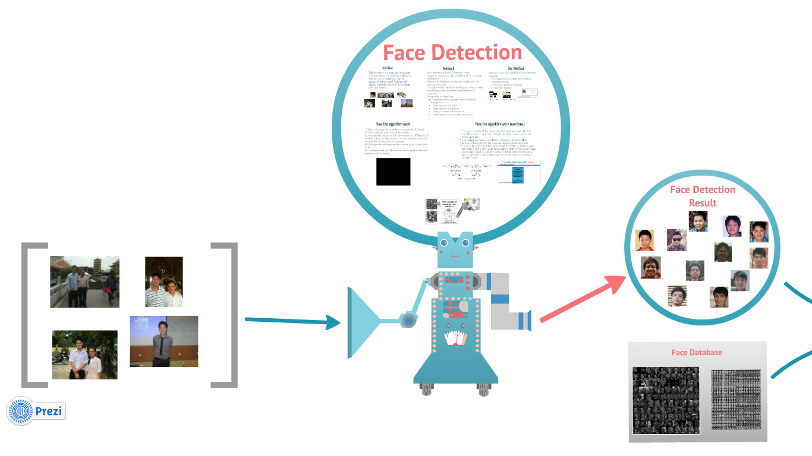
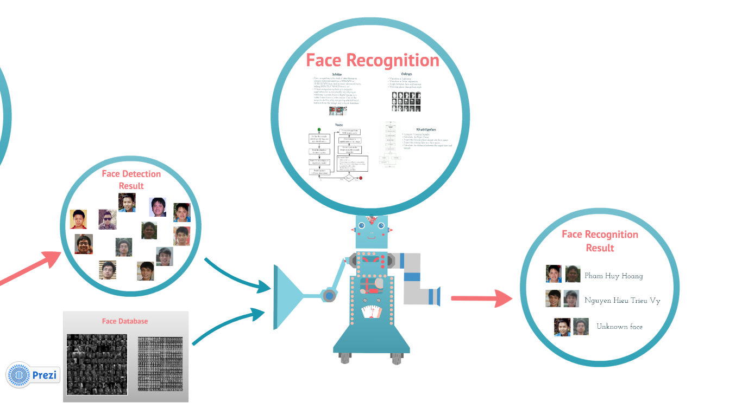
How Face Recognition Work

Slide 2
Phase 1: Face Detection

Slide 3
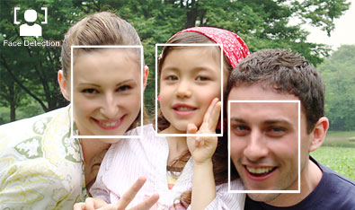
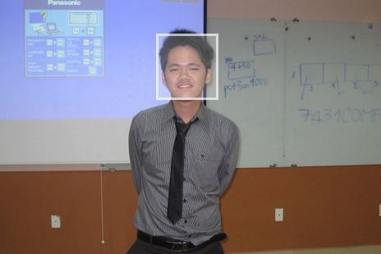
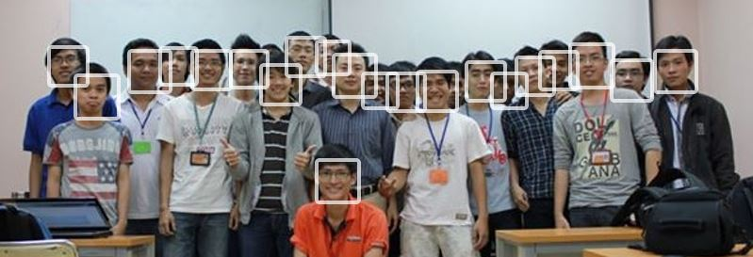
Definition
Face detection is a computer technology that determines the locations and sizes of human faces in arbitrary (digital) images.
It detects facial features and ignores anything else, such as buildings, trees and bodies.

Slide 4
Face Detection Method
Many way to detect face:
Finding faces in images with controlled background
Finding faces by color
Finding faces by motion
Using a mixture of the above
Finding faces in unconstrained scenes:

Slide 5
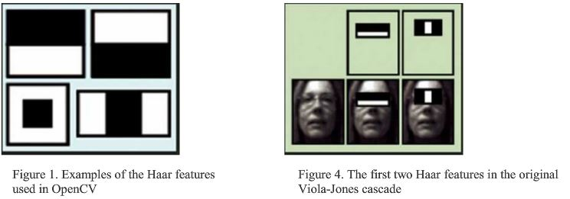
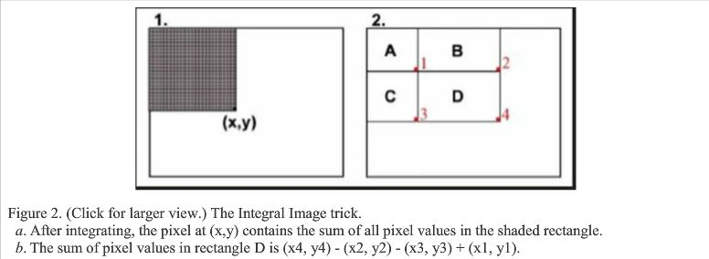
The method we choose
We use Viola-Jones method for face detection.
Concept:
Rectange feature, called Haar feature.
Intergral Image.
Ada-boost machine learning.
Cascased Classifier

Slide 6
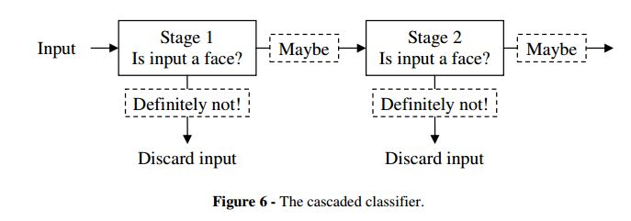
Algorithm
The basic principle of the Viola-Jones face detection algorithm is to scan the detector many times through the same image – each time with a new size.
This realization leads to a different formulation of the problem:
=> In stead of finding faces, the algorithm should discard non-faces.

Slide 7







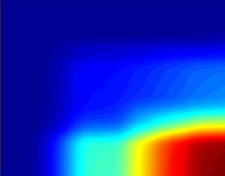

Training phase
Testing phase
Cascade trainer
Classifier cascade framework
Training
Set
(sub-windows)
Integral
Representation
Strong Classifier 1
(cascade stage 1)
Feature
computation
Strong Classifier 2
(cascade stage 2)
AdaBoost
Feature Selection
Strong Classifier N
(cascade stage N)
FACE IDENTIFIED
Slide courtesy: Kostantina Palla, University of Edinburgh
Notes:
בשר המאמר מתחיל בעצם עכשיו – עד עכשיו הדגמה.

Slide 8
Algorithm (Continue)
1) Opens an image and transforms to greyscale if needed.
2) Runs a sub-window through the image.
2a) Rescales the content of the sub-window to 24*24pixels (if needed). Check the Haar feature in each window. Move the sub-window if Haar feauture missing.
2b) Enlarges the sub-window by a given factor a goes back to 2).
2c) Continues until the sub-window size is equal to the least dimension of the image.

Slide 9
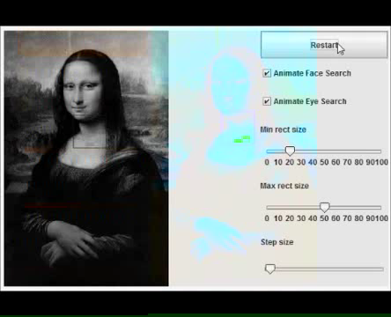

Slide 10
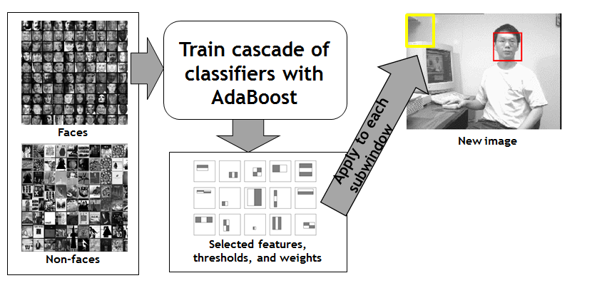
Summary

Slide 11
Phase 2: Face Recognition

Slide 12
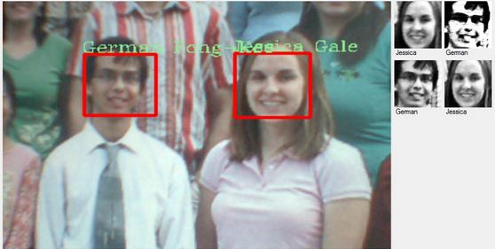
Definition
Face recognition is the task of identifying an already detected object as a KNOWN or UNKNOWN face, and in more advanced cases, telling EXACTLY WHO'S face it is!
One of the ways to do this is by comparing selected facial features from the image and a facial database.

Slide 13
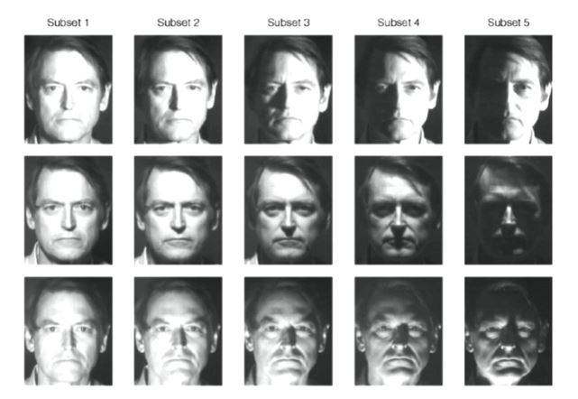
Challenges
Variation in lightning.
Variation in facial expression.
Angle between face and camera
Wearing glass, change hair style.

Slide 14
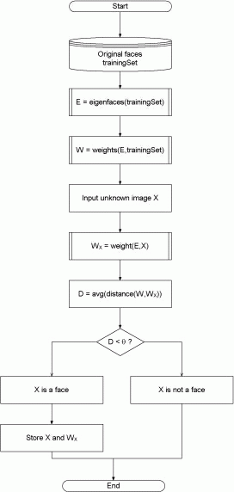
Sample Algorithm – Eigen Faces
Accquire Training Sample.
Calculate the Eigen Faces.
Project the training face image into face space.
Project the testing face into face space.
Calculate the distance between the input face and sample

Slide 15
The method we choose: Fisher Face
Reason:
Already implemented in openCV.
Has the best result, according to report.
http://asp.eurasipjournals.com/content/2012/1/92
Has the best result in our automation testing, with our current face database.

Slide 16













General workflow
FACE RECOGNIZER
TRAINED
Huy
Binh

